Slide 1
Marketing Analytics
Session 1
Course introduction & MySQL

Slide 2
Agenda
A brief bio
Course introduction
Marketing analytics
Course objective, methodology
Course material, software and downloads
Sessions
Grading
Assignments and term project
A crash course on database and SQL
Database
MySQL
SQL queries

Slide 3
Course introduction
Session 1

Slide 4
Analytics
Analytics is the discovery and communication of meaningful patterns in data

Slide 5
Marketing analytics
Marketing Analytics is the discovery and communication of meaningful patterns in marketing data

Slide 6
Marketing analytics
Domains of application:
Marketing optimization
Customer lifetime value
Segmentation and targeting
Sales forecast
Churn prediction
Customer preference
Cross-selling optimization (product recommendations)
New product development
Text mining and sentiment analysis
Web log analysis
Online analytics, bounce rate
Channel, touch points, attribution
Social networks
…

Slide 7

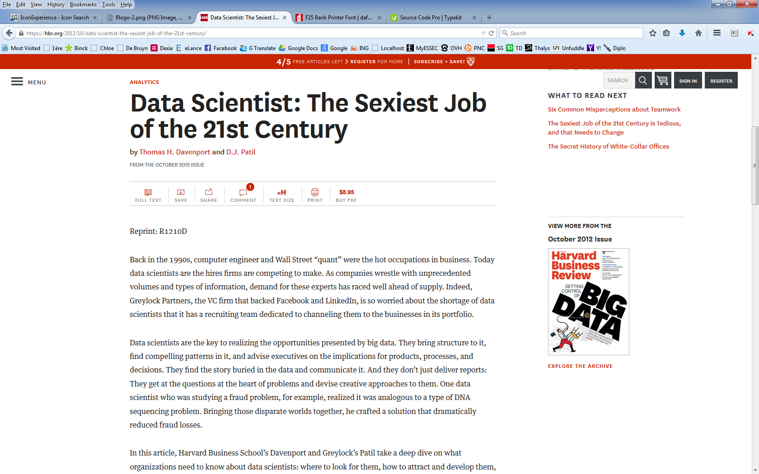

Slide 8

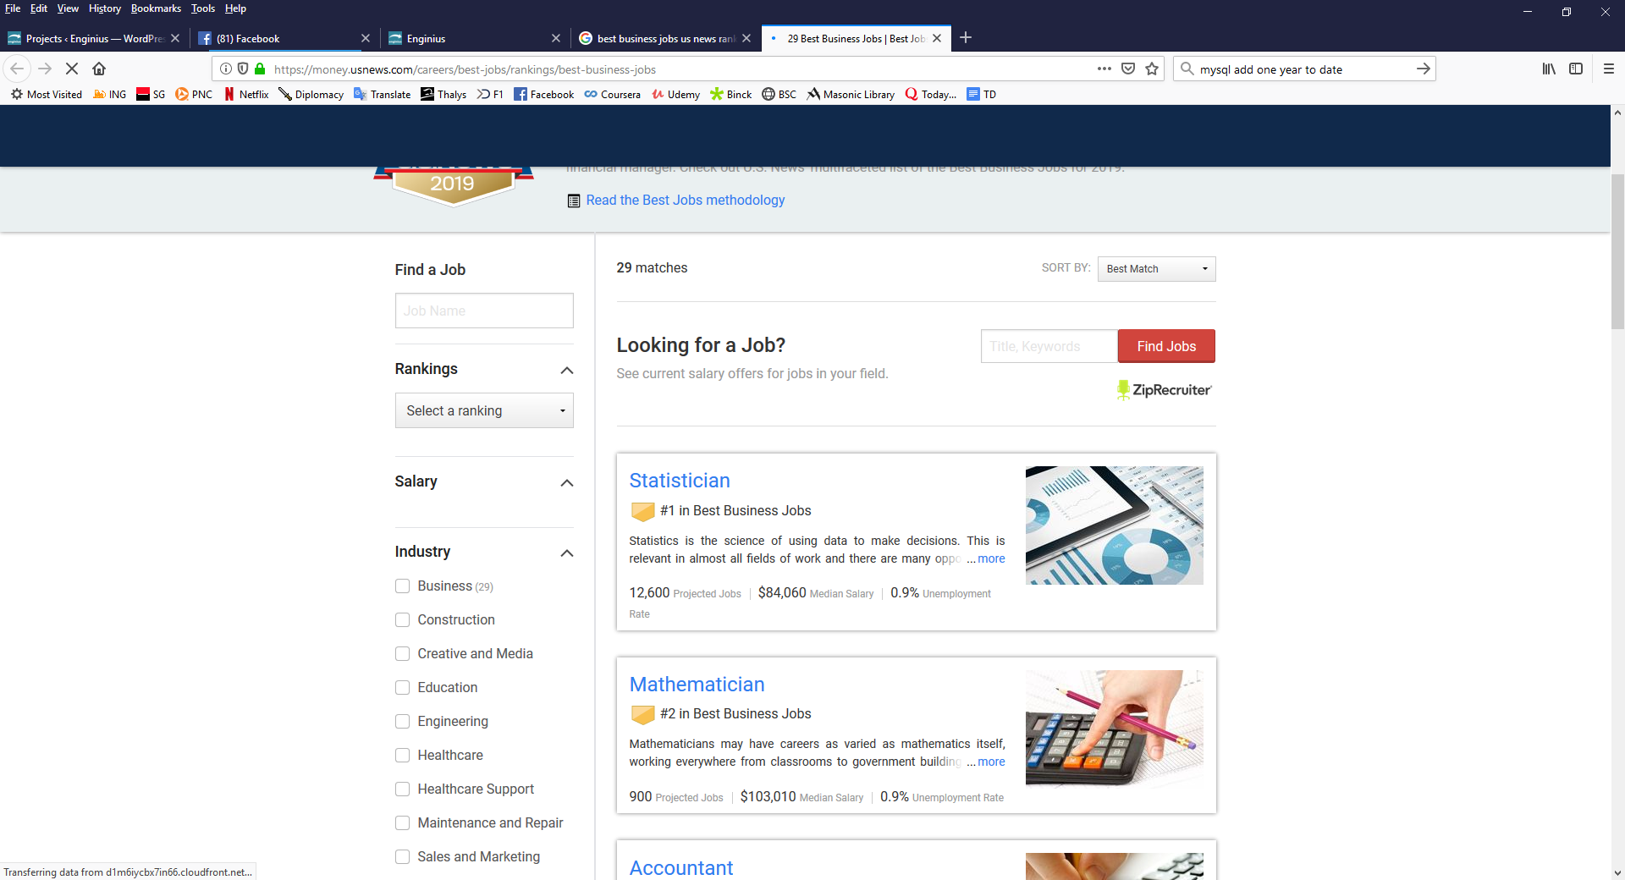
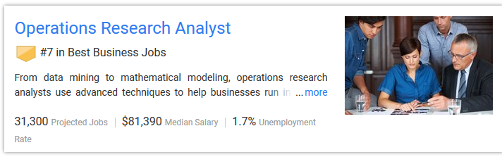

Slide 9
Course philosophy
Objective
Understand
Manage
Do
Methodology
Hands-on and practical
Technically-oriented
Focus on homework & coaching
Material
Open-source, widely used software
Low level programming

Slide 10




Marketing analytics process
EXTRACT
ANALYSE
REPORT
COMMUNICATE
EXPLORE
DEPLOY
VALIDATE
CLEAN
VIZUALISE
PREPARE

Slide 11
Extract
Database
Organized collection of data
Database management systems (DBMS)
Oracle, IBM, SAP, Microsoft, Teradata, MySQL, MariaDB, SQLLite, PostgreSQL…
Datawarehouse solutions
AWS, Google Cloud, Microsoft Azure, IBM cloud, OVH, Teradata…
Structured Query Language (SQL)
A query language for accessing databases
Shared by all DBMS (well, almost…)
EXTRACT

Slide 12
Analyze
Point-and-click software (with muscles)
TiMi, KXEN, SPSS Modeler, SAS Enterprise Miner, MiniTab
Programming languages
R, Python, MATLAB, C, C++, C#, Java
Tied to a specific database or hardware
Oracle, HANA (SAP)
Teradata, PureData (IBM)
ANALYSE

Slide 13
Report
Software focused on dashboards and report writing
Cognos (IBM), Business Objects (SAP), Pentaho
General office suite
PowerPoint, OpenOffice Impress, etc.
Home-made
ggplot, etc.
REPORT

Slide 14
Downloads (in that order)
MySQL (community) server (database engine)
MySQL notifier (recommended)
MySQL workbench
MySQL connector (ODBC)
http://dev.mysql.com/downloads/
Check MySQL Installer for Windows
R
http://www.r-project.org/
Be consistent in your downloads between server, ODBC connector, and R (e.g., Windows 64 bits)
RStudio desktop
http://www.rstudio.com/products/rstudio/
A few R libraries
When time comes…

Slide 15
If you have a Mac...
Try to install everything
Some managed to do it (see FAQ)
If you can’t make ODBC work
Run the SQL queries from MySQL Workbench
Save the results in text format
Import the text file in R (see FAQ)
If even MySQL does not work locally
Create a MySQL instance with a cloud provider
(e.g., https://aws.amazon.com/getting-started/hands-on/create-mysql-db/)
Use MySQL Workbench to connect remotely

Slide 16
Sessions
S1 – Oct 3
S2 – Oct 10
S3 – Oct 17
S4 – Oct 24
S5 – Oct 31
Course introduction
SQL
Segmentation
Data visualization
DUE DATE
Oct 30
Assignment 1
(report)
Database & SQL
R & ODBC
Scoring
S6 – Nov 7
S7 – Nov 21
S8 – Nov 28
S9 – Dec 5
S10 – Dec 12
Scoring
advanced topics
DUE DATE
Nov 20
DUE DATE
FRIDAY Dec 9
Assignment 2
(scoring)
Lifetime value
Market basket analysis
Assignment 3 (project)
Social network analysis
Q&A

Slide 17
Grading
Final grade
Assignment 1 30% (report)
Assignment 2 30% (individual performance)
Assignment 3 40% (report + code)
Challenge bonus
+1 if you beat me at Assignment #2
Qualitative evaluations
Peer evaluations
Professor evaluations based on class participation, attendance...
Usually between -1 and +2, but free to modify grade at will under exceptional circumstances (e.g., freeriding)

Slide 18

Assignments and term project
Groups
HW#3: Free to select your team
HW#2: Individual
HW#1: Random (but never with the same as HW#3)
Assignments
Using a customer database from the fundraising industry
ASSIGNMENT 1
ASSIGNMENT 2
ASSIGNMENT 3

Slide 19
Resources on the course website
Slides
SQL queries, R code, etc., as text files
Don't copy-paste from PowerPoint, due to special characters
Additional documents
Assignments
Etc.
FAQ
Common installation issues
Data description
Additional files (e.g., student contribution)

Slide 20




Four more things...
Google Award
I’m not infallible
Contribute to the group
No computer (3rd session onward)
Webcam, attendance, etc.

Slide 21
Next…
Database
Definition
Relational database
DBMS
Other trends in data storage
MySQL
Installation and configuration
Tools
SQL queries
Create, insert, delete, select, join…

Slide 22
DATABASE

Slide 23
Database
Database
Organized collection of data
Many different types of databases
Relational database
A database has multiple tables
A table has multiple fields
Each field has a specific, clearly-defined format
Some fields are used as keys to link tables together
Some fields are indexed to facilitate search and query

Slide 24
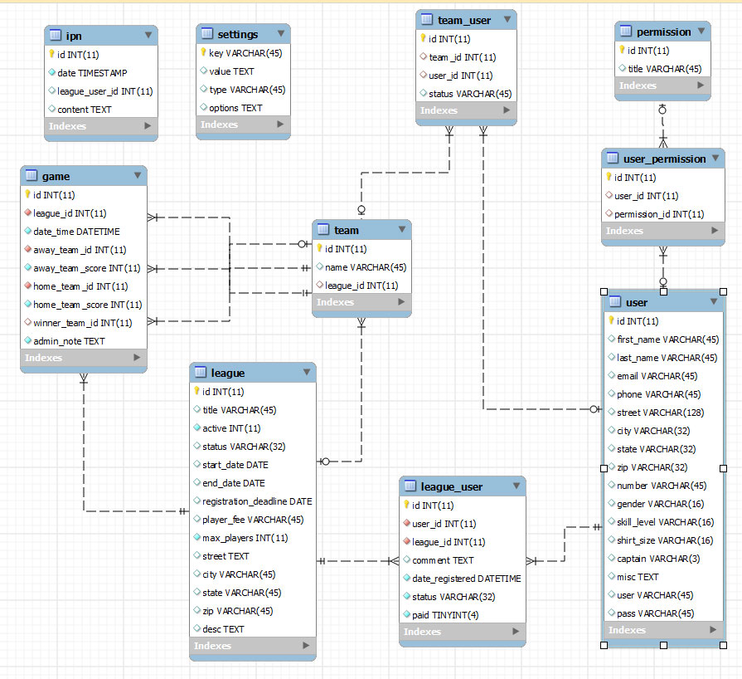
Database

Slide 25
Database
Keys
One-to-one
One-to-many
Each field type is well-defined, but freedom exists…
VARCHAR, BLOB, Etc.
Practical issues and common frustrations
Badly-defined fields (type)
Badly-defined fields (length)
Impact of changing field definitions once online (screens)
Unused table space
Badly-defined or missing indexes
Etc.

Slide 26
DBMS
Database management systems (DBMS)
DBMSs are computer software applications that interact with the user, other applications, and the database itself to capture and analyze data
Core functions
Define and create databases, tables
Insert, update and delete data
Query (extract) data
Manage
Save and export
Etc.

Slide 27
DBMS
Leaders in relational DBMS
Oracle Database
MySQL (Oracle Corporation)
MariaDB
Amazon Aurora
Microsoft SQL Server
PostgreSQL
IBM DB2
IBM Informix
SAP Sybase Adaptive Server Enterprise
SAP Sybase IQ
Teradata
…

Slide 28
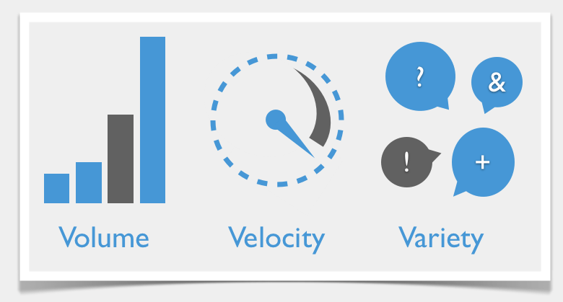
Trends in data storage
Big data characteristics
Volume – large data sets, with millions of rows
Velocity – data is generated and needs to be exploited fast
Variety – unstructured data such as text, images, etc.

Slide 29
Trends in data storage
Additional solutions have emerged regarding databases, data storage and data access
NoSQL “post-relational databases”
Hadoop “distributed storage and applications”
Etc.

Slide 30
mysql
Open-source RDBMS

Slide 31
MySQL
Most widely used open-source RDBMS
Especially prevalent in Web applications
LAMP open-source Web application software stack
Linux → operating system (e.g., Ubuntu)
Apache → Web server
MySQL → database
PHP/Perl/Python → Web programming
Owned by Oracle, source code available under a GNU General Public License (free software license)
Exists for Windows, Mac OS, Linux, etc.

Slide 32
MySQL download
Download and install MySQL
A few tips
Use default options (port number 3306, open firewall)
Think about changing MySQL data directory
Use Workbench or other tool
Or open “my.cnf” or “my.ini” and search for “datadir”
On Windows, install as a service, but do not launch at startup

Slide 33
SQL QUERIES
SQL boot camp

Slide 34
Please note…
All the code sources and queries discussed in this course can be found in uploaded text files
For this course:
“Session 1 – SQL queries.txt”
Do NOT copy-paste from PowerPoint to MySQL
Characters like ‘ ’ ' ` ´ may appear identical in PowerPoint, but only some of them are valid characters in a MySQL query
The same goes for the 3 characters “ ” "

Slide 35
Database manipulation
# Find where data files are stored locally
# SHOW VARIABLES WHERE Variable_Name = ‘datadir’;
# in older versions of MySQL. Otherwise:
SHOW VARIABLES LIKE `datadir`;
# Create an empty database
CREATE DATABASE ma_charity;
# Show the existing databases
SHOW DATABASES;
# Use a specific database
USE ma_charity;

Slide 36
To create a table
Give the table a name
For each field
Give the field a name
Specify its type
Specify its length, if required
Specify options
UNSIGNED if only positive values expected ⁽*⁾
NOT NULL if cannot be empty
DEFAULT ‘…’ to assign default value when left empty
AUTO_INCREMENT, useful for numeric keys with no other meaning
…
For indexes (or keys)
Give the index a name (even if rarely used later)
Specify which field(s) it indexes (might be just one), in which order
One index should be PRIMARY
* “Why Gandhi Is Such An Asshole In Civilization” https://kotaku.com/why-gandhi-is-such-an-asshole-in-civilization-1653818245

Slide 37
Data types
# Numeric Data Types
INT An integer that can be signed or unsigned
TINYINT A very small integer (0..255 or -128..127)
SMALLINT A small integer (-32768..32767 or 0..65535)
FLOAT(M,D) A floating-point number that cannot be unsigned. Display length (M) and the number of decimals (D) default to 10,2
DOUBLE(M,D) A double precision floating-point number that default to M=16 and D=4. REAL is a synonym for DOUBLE.
# Date and Time Types
DATE A date in YYYY-MM-DD format
DATETIME A date and time combination in YYYY-MM-DD HH:MM:SS format
# String Types
CHAR(M) A fixed-length string (1-255 characters)
VARCHAR(M) A variable-length string (1-255 characters)
BLOB or TEXT A field with a maximum length of 65535 characters
ENUM An enumeration. With ENUM ('A', 'B', 'C'), only those values (or NULL) can populate the field

Slide 38
Create table
# Create contact table
CREATE TABLE `contacts` (
`id` int(10) unsigned NOT NULL AUTO_INCREMENT,
`prefix_id` varchar(5) DEFAULT NULL,
`first_name` varchar(32) DEFAULT NULL,
`zip_code` varchar(5) DEFAULT NULL,
`town` varchar(60) DEFAULT NULL,
`code_geo` varchar(5) DEFAULT NULL,
`active` tinyint(3) unsigned DEFAULT 1,
PRIMARY KEY (`id`)
);

Slide 39
Load data from file
# Load a text file into a table
# (Please note this is an hypothetical example,
# just so you know how to load a text file into an
# existing table. It will NOT work if you run it.)
LOAD DATA LOCAL INFILE
'C:/Documents/Databases/charity/contacts.txt’
INTO TABLE contacts;

Slide 40
Insert, update, or delete rows
# Insert a row in a table
# Note that AUTO_INCREMENT fields... auto increment
# Field names are optional if you set a value for all
# Watch out for the NOT NULL fields
INSERT INTO contacts
(id, prefix_id, first_name, zip_code)
VALUES (249280, "MR", "ARNAUD", 95000);
# Update a row
UPDATE contacts
SET prefix_id = "DR"
WHERE id = 249280;
# Delete a row
DELETE FROM contacts
WHERE id = 249280;

Slide 41
Select (list) data
# Select (list) all data from a table
SELECT * FROM contacts;
# Select all data from a table, and save into file
SELECT * INTO OUTFILE 'contacts.txt' FROM contacts;
# Select specific fields from a table
SELECT first_name, zip_code FROM contacts;

Slide 42
Select aggregate functions
# Select aggregate functions
SELECT MIN(act_date),
MAX(act_date),
COUNT(*),
SUM(amount),
AVG(amount)
FROM acts;

Slide 43
Why not compute aggregates outside MySQL
Much more efficient to do it within MySQL
Optimized to that avail
No need to extract or transfer the entire data set
No need to store data in memory
Etc.
Especially efficient when the goal is to populate the database with the results (cf. segmentation in 2 weeks)
Not a big issue with a few thousands rows, but with millions…

Slide 44
Rename output
# Rename output (alias)
SELECT MIN(act_date) AS firstgift,
MAX(act_date) AS lastgift,
COUNT(*) AS numgifts,
SUM(amount) AS sumgifts,
AVG(amount) AS averagegift
FROM acts;

Slide 45
Group and sort output
# Sum of donations, per year
SELECT YEAR(act_date), SUM(amount)
FROM acts
GROUP BY 1
ORDER BY 1;
# This is equivalent, with an alias, and
# listed in decreasing order
# Notice the character ` so MySQL is not confused
# (YEAR is a reserved keyword)
SELECT YEAR(act_date) AS `year`, SUM(amount)
FROM acts
GROUP BY `year`
ORDER BY `year` DESC;

Slide 46
Group and sort output (additional example)
# List first names in decreasing order of occurrence
SELECT first_name, COUNT(*)
FROM contacts
GROUP BY 1
ORDER BY 2 DESC;
# List the ten most common first names
SELECT first_name, COUNT(*)
FROM contacts
GROUP BY 1
ORDER BY 2 DESC
LIMIT 10;

Slide 47
Group and sort output (additional example)
# List donors and key marketing indicators
# by decreasing order of average donation
SELECT contact_id,
AVG(amount) AS averageamount,
COUNT(*) AS numdonations,
SUM(amount) AS totalgenerosity
FROM acts
GROUP BY contact_id
ORDER BY averageamount DESC;

Slide 48
Introduce conditions
# List gifts of 1000 EUR or more
SELECT *
FROM acts
WHERE amount >= 1000;

Slide 49
Introduce conditions (additional example)
# List donors who made gifts of 1000 EUR or more
SELECT contact_id
FROM acts
WHERE amount >= 1000
ORDER BY contact_id;
# Same, but exclude duplicates
SELECT DISTINCT(contact_id)
FROM acts
WHERE amount >= 1000
ORDER BY contact_id;

Slide 50
Introduce conditions (additional example)
# List the ten most common first names,
# but exclude NULL values
SELECT first_name, COUNT(*)
FROM contacts
WHERE first_name IS NOT NULL
GROUP BY first_name
ORDER BY 2 DESC
LIMIT 10;
# This is equivalent...
# COUNT(*) = number of rows
# COUNT(field) = number of non-null values
# /!\ NULL values are EVIL
SELECT first_name, COUNT(first_name)
FROM contacts
GROUP BY first_name
ORDER BY 2 DESC
LIMIT 10;

Slide 51
Join tables
# List contact information of donors who made
# single donations of 1000 EUR or more
# But you will have duplicates !!!
SELECT contacts.id,
contacts.first_name,
contacts.prefix_id,
contacts.zip_code
FROM contacts
JOIN acts
ON contacts.id = acts.contact_id
WHERE acts.amount >= 1000;

Slide 52
Join tables
# List contact information of donors who made
# single donations of 1000 EUR or more
# GROUP BY will remove duplicates,
# BUT IT MAY NOT WORK, depending on MySQL version
SELECT contacts.id,
contacts.first_name,
contacts.prefix_id,
contacts.zip_code
FROM contacts
JOIN acts
ON contacts.id = acts.contact_id
WHERE acts.amount >= 1000
GROUP BY contacts.id;

Slide 53
Join tables
# This will always work,
# regardless of your MySQL version
SELECT contacts.id,
ANY_VALUE(contacts.first_name),
ANY_VALUE(contacts.prefix_id),
ANY_VALUE(contacts.zip_code)
FROM contacts
JOIN acts
ON contacts.id = acts.contact_id
WHERE acts.amount >= 1000
GROUP BY contacts.id;

Slide 54
Join tables (less verbose)
# This is equivalent, less verbose, no ambiguity
SELECT c.id,
ANY_VALUE(c.first_name),
ANY_VALUE(c.prefix_id),
ANY_VALUE(c.zip_code)
FROM contacts AS c
JOIN acts AS a
ON c.id = a.contact_id
WHERE a.amount >= 1000
GROUP BY c.id;

Slide 55
Join tables (less verbose)
# This is also equivalent, with a WHERE clause
SELECT c.id,
ANY_VALUE(c.first_name),
ANY_VALUE(c.prefix_id),
ANY_VALUE(c.zip_code)
FROM contacts AS c,
acts AS a
WHERE (c.id = a.contact_id)
AND (a.amount >= 1000)
GROUP BY c.id;

Slide 56
Join tables (another example)
# List the most generous first names
SELECT c.first_name,
FLOOR(AVG(a.amount)) AS averagegift
FROM acts AS a
JOIN contacts AS c
ON a.contact_id = c.id
GROUP BY 1
ORDER BY 2 DESC;

Slide 57
Join tables (another example)
# List the most generous first names, but only
# if there are enough observations
# HAVING is “like” WHERE, but used after grouping
SELECT c.first_name,
FLOOR(AVG(a.amount)) AS averagegift
FROM acts AS a
JOIN contacts AS c
ON a.contact_id = c.id
GROUP BY 1
HAVING COUNT(c.first_name) >= 10
ORDER BY 2 DESC;

Slide 58
Join tables (another example)
# Compute key marketing indicators for each donor
# Since we are computing aggregate functions,
# do not forget GROUP BY
# ('dpt' stands for 'department’)
# Warning: we are missing contacts. Why?
SELECT c. id,
LEFT(ANY_VALUE(c.zip_code), 2) AS dpt,
MIN(a.act_date) AS firstgift,
MAX(a.act_date) AS recency,
CEILING(AVG(a.amount)) AS avgamount,
COUNT(a.amount) AS frequency
FROM contacts AS c
JOIN acts AS a
ON c.id = a.contact_id
GROUP BY c.id;

Slide 59
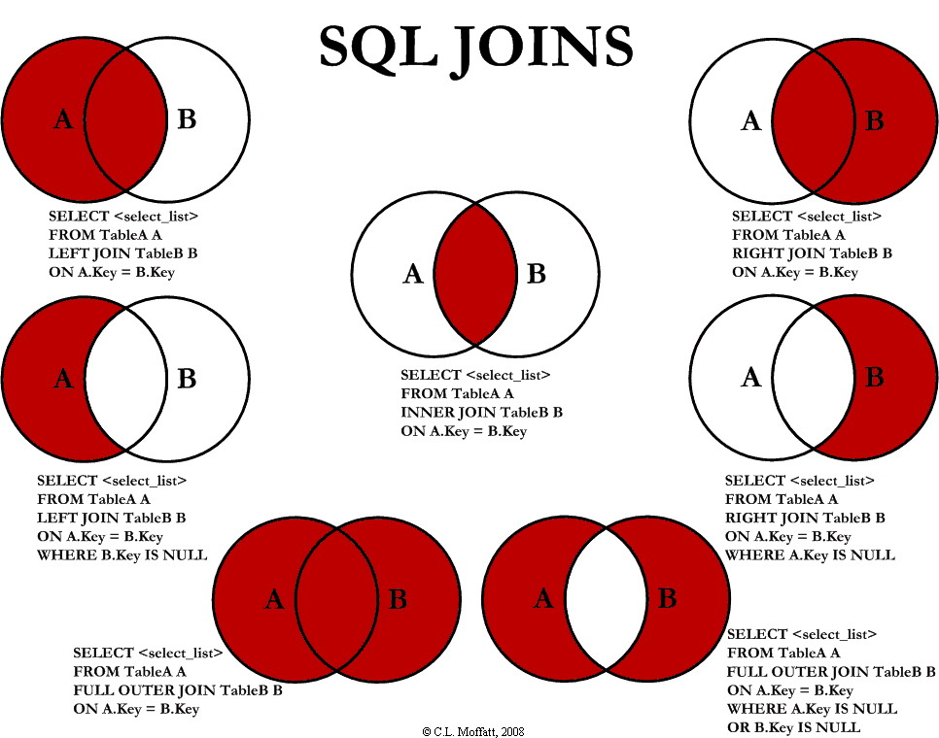
Different types of SQL JOINs
http://www.codeproject.com/Articles/33052/Visual-Representation-of-SQL-Joins, author C. L. Moffatt
This article, along with any associated source code and files, is licensed under The Code Project Open License (CPOL)

Slide 60
Different types of SQL JOINs
Those are equivalent or synonymous :
FROM … JOIN … ON …
FROM … INNER JOIN … ON …
FROM …, … WHERE …
Those are equivalent:
FROM contacts LEFT JOIN acts
FROM acts RIGHT JOIN contacts

Slide 61
Different types of SQL JOINs
http://www.codeproject.com/Articles/33052/Visual-Representation-of-SQL-Joins, author C. L. Moffatt
This article, along with any associated source code and files, is licensed under The Code Project Open License (CPOL)

Slide 62
Join tables (another example)
# Compute key marketing indicators for each donor,
# including those with no donation history
SELECT c. id,
LEFT(ANY_VALUE(c.zip_code), 2) AS dpt,
MIN(a.act_date) AS firstgift,
MAX(a.act_date) AS recency,
CEILING(AVG(a.amount)) AS avgamount,
COUNT(a.amount) AS frequency
FROM contacts AS c
LEFT JOIN acts AS a
ON c.id = a.contact_id
GROUP BY c.id;

Slide 63
It can be troubling…
In this specific charity context, those queries will return the same results, though:
FROM contacts JOIN acts
FROM contacts INNER JOIN acts
FROM contacts, acts WHERE
FROM contacts RIGHT JOIN acts
FROM acts LEFT JOIN contacts
Because in this database, there is no donation (act) that doesn’t have a corresponding entry in the contact table
CONTACTS
ACTS
CONTACTS
ACTS

Slide 64
Compute aggregates on query results
# Count the number of donors by frequency
# of regular donations (“DO”), excluding
# automatic deductions (“PA”)
# Step 1, compute frequencies
SELECT contact_id, COUNT(*) AS frequency
FROM acts
WHERE act_type_id LIKE "DO"
GROUP BY contact_id;

Slide 65
Compute aggregates on query results
# Count the number of donors by frequency
# Step 2, group donors by frequencies
# Note that every derived table needs its own alias
SELECT COUNT(frequency) AS counter, frequency
FROM (SELECT contact_id, COUNT(*) AS frequency
FROM acts
WHERE act_type_id LIKE "DO“
GROUP BY contact_id) AS q
GROUP BY frequency
ORDER BY frequency;

Slide 66
Joining tables and query results
# Report average frequency and donation amount
# by prefix
# Step 1
SELECT contact_id,
COUNT(*) AS frequency,
AVG(amount) AS avgamount
FROM acts
WHERE act_type_id LIKE "DO“
GROUP BY contact_id;

Slide 67
Joining tables and query results
# Report average frequency and donation amount
# by prefix, step 2
# Note the difference between computing
# AVG(amount) and AVG(avgamount)
SELECT prefix_id,
AVG(frequency),
AVG(avgamount),
COUNT(*)
FROM contacts c
JOIN (SELECT contact_id,
COUNT(*) AS frequency,
AVG(amount) AS avgamount
FROM acts
WHERE act_type_id LIKE "DO"
GROUP BY contact_id) AS q
ON c.id = q.contact_id
GROUP BY 1
ORDER BY 2 DESC;

Slide 68
Multiple joins
# Compute number of regular donations and number
# of automatic deductions for all donors
# Note: query may be a bit slower
SELECT c.id, d.frequency, p.frequency
FROM contacts c
LEFT JOIN (SELECT contact_id, COUNT(*) AS frequency
FROM acts WHERE act_type_id LIKE "DO"
GROUP BY 1) AS d
ON c.id = d.contact_id
LEFT JOIN (SELECT contact_id, COUNT(*) AS frequency
FROM acts WHERE act_type_id LIKE "PA"
GROUP BY 1) AS p
ON c.id = p.contact_id
ORDER BY c.id;

Slide 69
That’s all folks !

